Slide 1
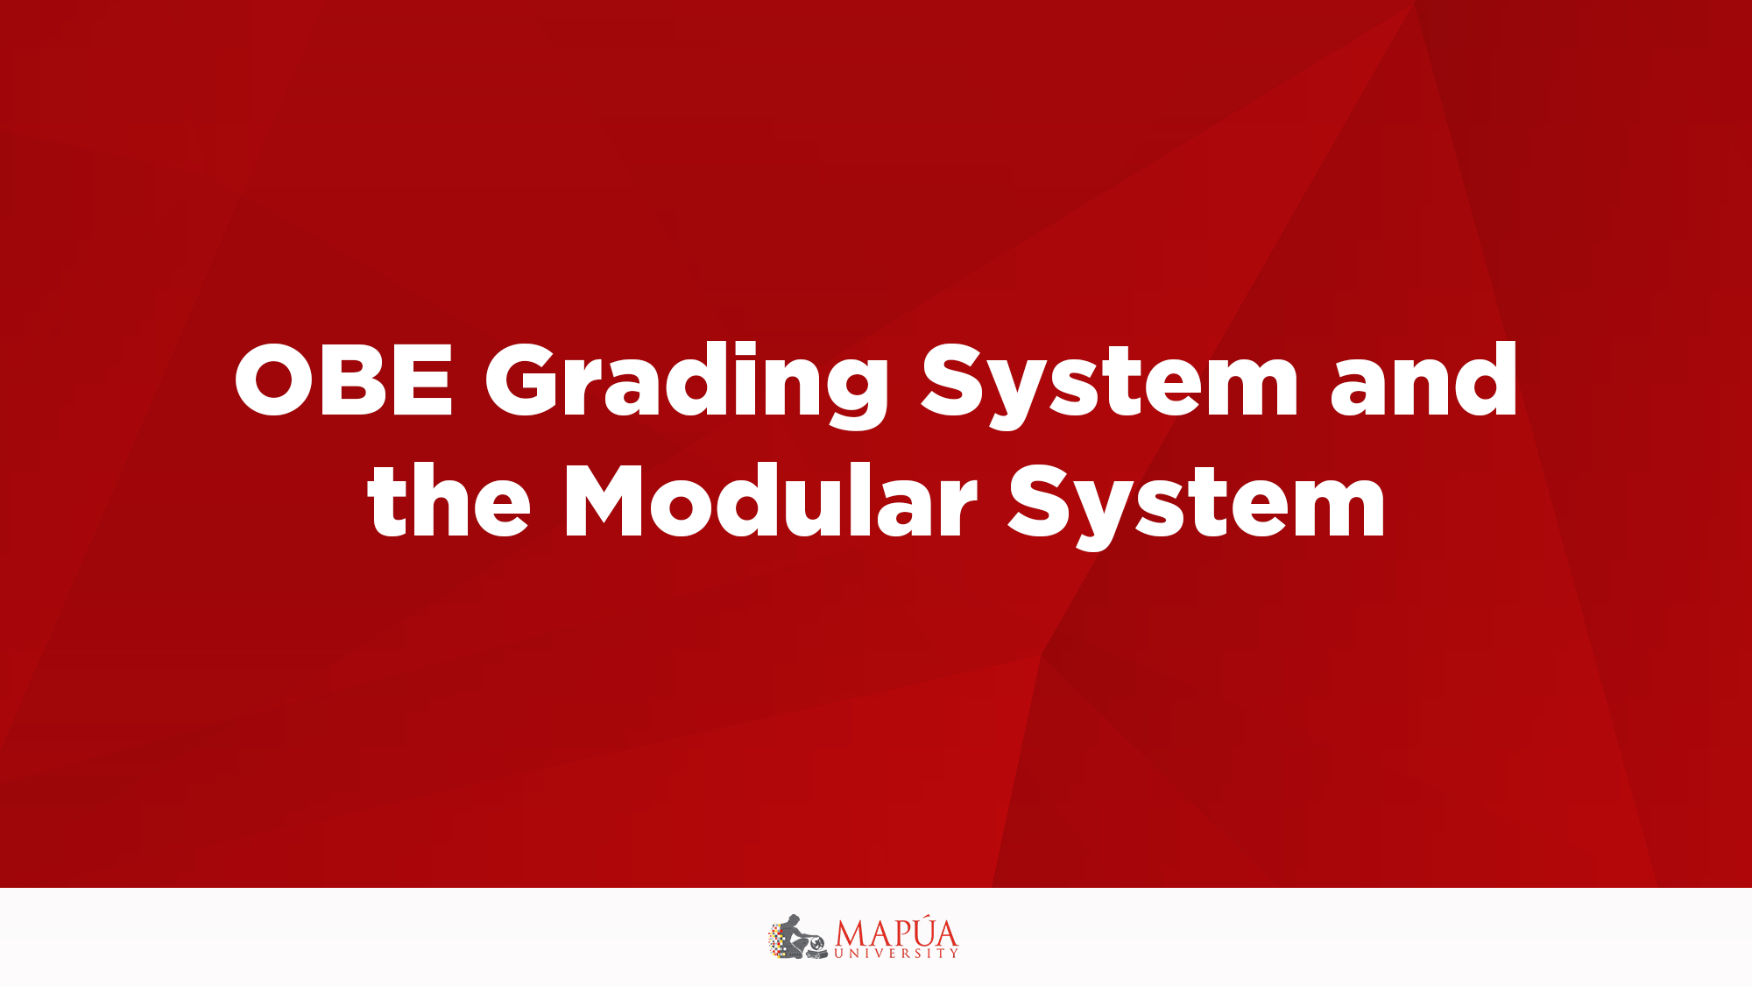
Overview of Computers and Programming Languages

Slide 2
Introduction
Without software, the computer is useless
Software developed with programming languages
  C++ is a programming language
C++ suited for a wide variety of programming tasks
Before programming, it is useful to understand terminology and computer components

Slide 3
A Brief Overview of the History of Computers
Early calculation devices
  Abacus, Pascaline
  Leibniz device
  Babbage machines: difference and analytic engines
  Hollerith machine

Slide 4
A Brief Overview of the History of Computers
Early computer-like machines
  Mark I
  ENIAC
  Von Neumann architecture
  UNIVAC
  Transistors and microprocessors

Slide 5
A Brief Overview of the History of Computers
Categories of computers
  Mainframe computers
  Midsize computers
  Micro computers (personal computers)

Slide 6
Elements of a Computer System
Hardware
CPU
Main memory
Secondary storage
Input/Output devices
Software

Slide 7
Hardware
CPU
Main memory: RAM
Input/output devices
Secondary storage

Slide 8
Central Processing Unit and Main Memory
Central processing unit
  Brain of the computer
  Most expensive piece of hardware
  Carries out arithmetic and logical operations

Slide 9
Central Processing Unit and Main Memory
Random access memory
Directly connected to the CPU
All programs must be loaded into main memory before they can be executed
All data must be brought into main memory before it can be manipulated
When computer power is turned off, everything in main memory is lost

Slide 10
Secondary Storage
Secondary storage: device that stores information permanently
Examples of secondary storage:
  Hard disks
  Flash drives
  Floppy disks
  Zip disks
  CD-ROMs
  Tapes

Slide 11
Input/Output Devices
Input devices feed data and programs into computers
  Keyboard
  Mouse
  Secondary storage
Output devices display results
  Monitor
  Printer
  Secondary storage

Slide 12
Software
Software: programs that do specific tasks
System programs take control of the computer, such as an operating system
Application programs perform a specific task
  Word processors
  Spreadsheets
  Games
C++ Programming: From Problem Analysis to Program Design, Fifth Edition

Slide 13
The Language of a Computer
Digital signals: sequences of 0s and 1s
Machine language: language of a computer
Binary digit (bit):
  The digit 0 or 1
Binary code:
  A sequence of 0s and 1s
Byte:
  A sequence of eight bits

Slide 14
The Language of a Computer
ASCII (American Standard Code for Information Interchange)
  128 characters
  A is encoded as 1000001 (66th character)
  3 is encoded as 0110011

Slide 15
The Language of a Computer
EBCDIC
  Used by IBM
  256 characters
Unicode
  65536 characters
  Two bytes are needed to store a character

Slide 16
Processing a C++ Program
#include <iostream>
using namespace std;
int main()
{
cout << “Hello World!." << endl;
return 0;
}
Sample Run:
Hello World!.

Slide 17
Processing a C++ Program
To execute a C++ program:
  Use an editor to create a source program in C++
  Preprocessor directives begin with # and are processed by a the preprocessor
  Use the compiler to:
    Check that the program obeys the rules
    Translate into machine language (object program)

Slide 18
Processing a C++ Program
To execute a C++ program:
  Linker:
    Combines object program with other programs provided by the SDK to create executable code
  Loader:
    Loads executable program into main memory
  The last step is to execute the program

Slide 19
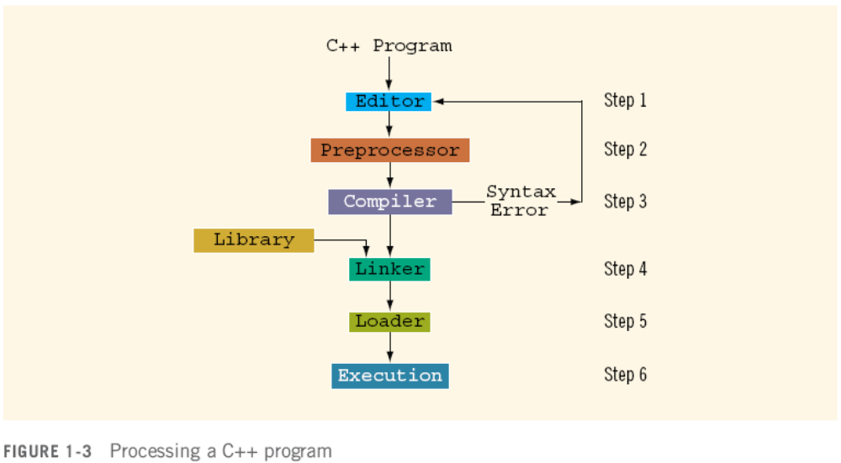
Processing a C++ Program

Slide 20
Programming with the Problem Analysis–Coding–Execution Cycle
Programming is a process of problem solving
One problem-solving technique:
  Analyze the problem
  Outline the problem requirements
  Design steps (algorithm) to solve the problem
Algorithm:
  Step-by-step problem-solving process
  Solution achieved in finite amount of time

Slide 21
The Problem Analysis–Coding–Execution Cycle
Step 1: Analyze the problem
  Outline the problem and its requirements
  Design steps (algorithm) to solve the problem
Step 2: Implement the algorithm
  Implement the algorithm in code
  Verify that the algorithm works
Step 3: Maintenance
  Use and modify the program if the problem domain changes

Slide 22
The Problem Analysis–Coding–Execution Cycle
Thoroughly understand the problem
Understand problem requirements
  Does program require user interaction?
  Does program manipulate data?
  What is the output?
If the problem is complex, divide it into subproblems
  Analyze each subproblem as above

Slide 23
The Problem Analysis–Coding–Execution Cycle
If problem was broken into subproblems
  Design algorithms for each subproblem
Check the correctness of algorithm
  Can test using sample data
  Some mathematical analysis might be required

Slide 24
The Problem Analysis–Coding–Execution Cycle
Once the algorithm is designed and correctness verified
  Write the equivalent code in high-level language
Enter the program using text editor

Slide 25
The Problem Analysis–Coding–Execution Cycle
Run code through compiler
If compiler generates errors
  Look at code and remove errors
  Run code again through compiler
If there are no syntax errors
  Compiler generates equivalent machine code
Linker links machine code with system resources

Slide 26
The Problem Analysis–Coding–Execution Cycle
Once compiled and linked, loader can place program into main memory for execution
The final step is to execute the program
Compiler guarantees that the program follows the rules of the language
  Does not guarantee that the program will run correctly

Slide 27
Programming Methodologies
Two popular approaches to programming design
  Structured
  Object-oriented

Slide 28
Structured Programming
Structured design:
  Dividing a problem into smaller subproblems
Structured programming:
  Implementing a structured design
The structured design approach is also called:
  Top-down (or bottom-up) design
  Stepwise refinement
  Modular programming

Slide 29
Object-Oriented Programming
Identify components called objects
Specify relevant data and possible operations to be performed on that data
Each object consists of data and operations on that data
An object combines data and operations on the data into a single unit

Slide 30
Object-Oriented Programming
A programming language that implements OOD is called an object-oriented programming (OOP) language
Learn how to represent data in computer memory, how to manipulate data, and how to implement operations
Write algorithms and implement them in a programming language

Slide 31
Object-Oriented Programming
Learn how to combine data and operations on the data into a single unit called an object
C++ was designed to implement OOD
OOD is used with structured design

Slide 32
ANSI/ISO Standard C++
C++ evolved from C
C++ designed by Bjarne Stroustrup at Bell Laboratories in early 1980s
C++ programs were not always portable from one compiler to another
In mid-1998, ANSI/ISO C++ language standards were approved

Slide 33


